Slide 1
Team 3 Capstone 2019
Fayetteville technical community college

Slide 2
Part 1: the Team, the Project
Who are they and what are they doing?

Slide 3
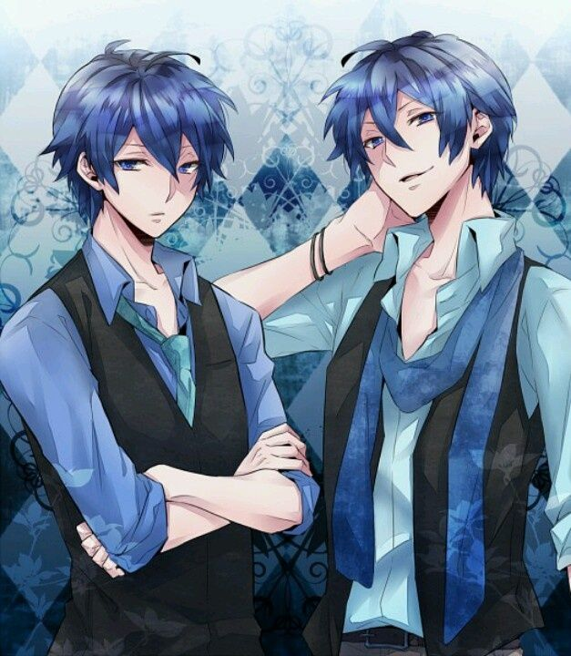
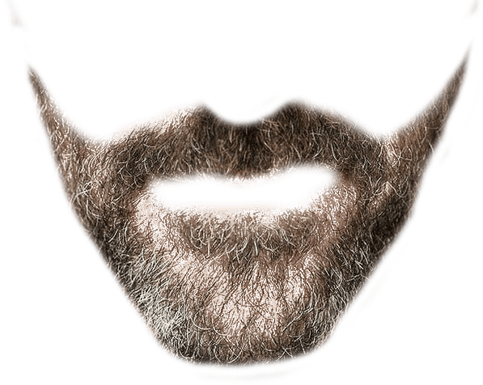
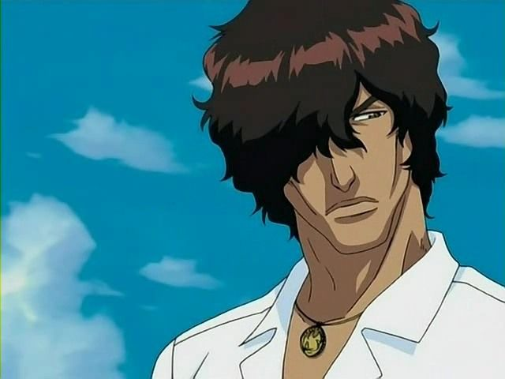


Who is Team 3?
- Scott and Michael Blythe
(Actually blonde, but you try finding
blonde bearded anime guys)
- Juan Santiago
(Pikachu hoodie for life)
- Alex Lopez
(Hair slicked back read to attack)
- Bethany Reagan
(Is really hungry right now)

Slide 4

How can I find more anime???

Slide 5

AniRater
Watching anime, immersion for us.
Are you happy now, Mr. Norris?

Slide 6
AniRater
A web-based program intended to:
Present various anime movies and TV shows to the otaku
Allow users to review, rate, and view listings of the shows/films they’ve liked
Creates recommendations of new shows to watch in the future.

Slide 7
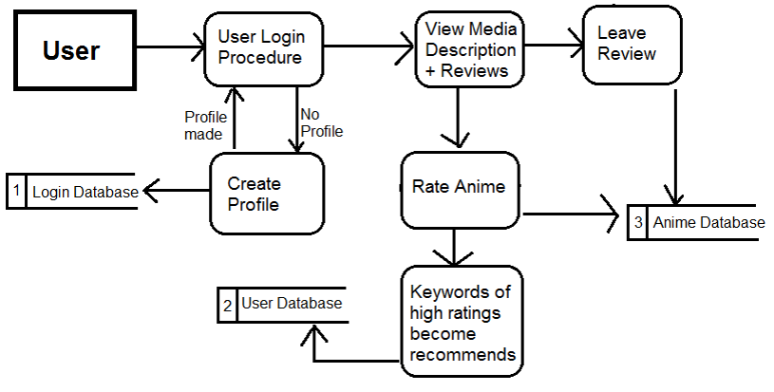


The General Idea – Data Flow

Slide 8
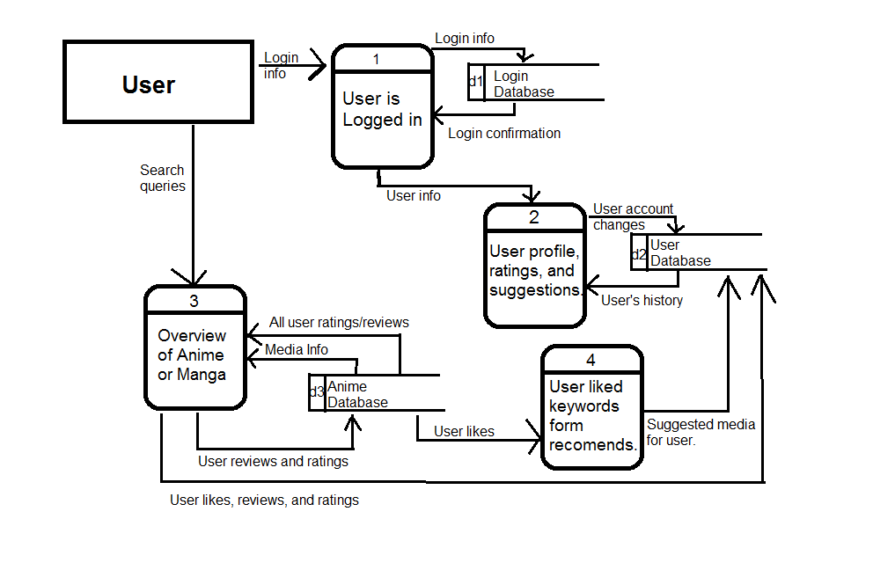
Diagram Zero

Slide 9
Part 2: the User Experience
How do we do reviews and ratings?

Slide 10
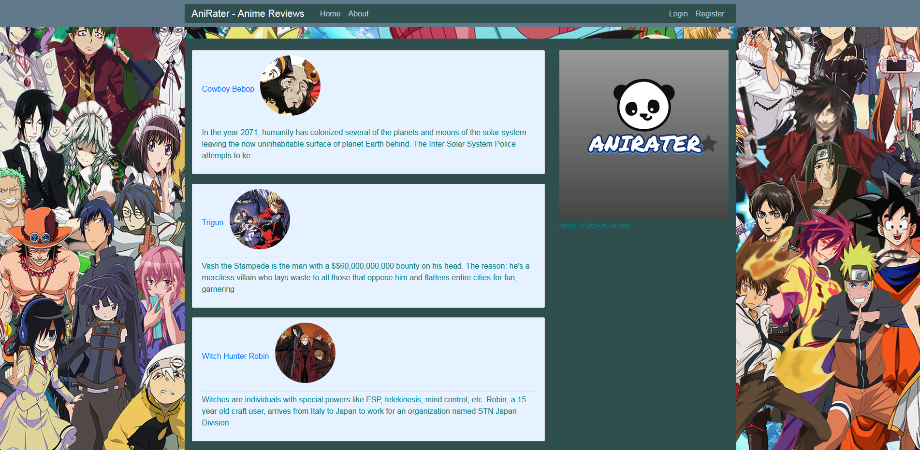
Viewing Reviews:
The Homepage

Slide 11
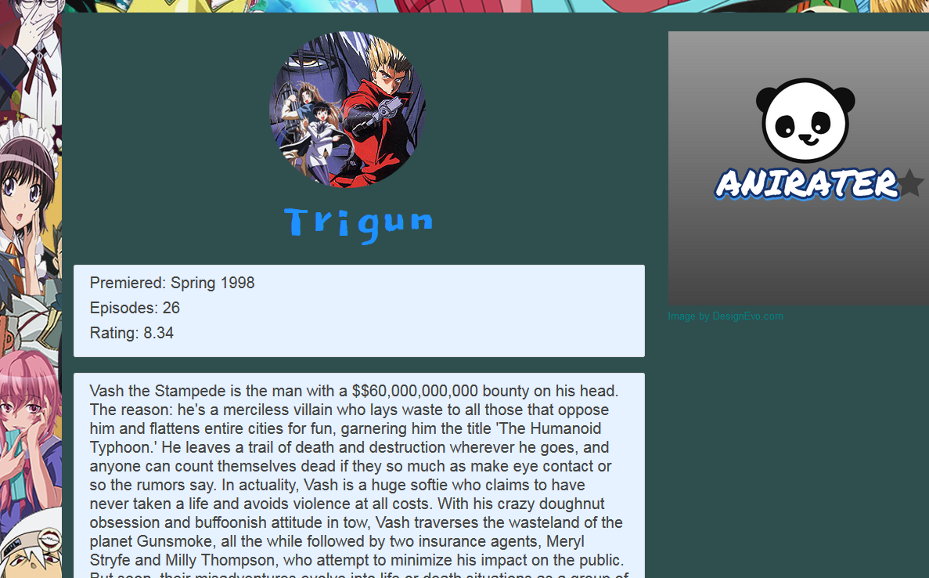
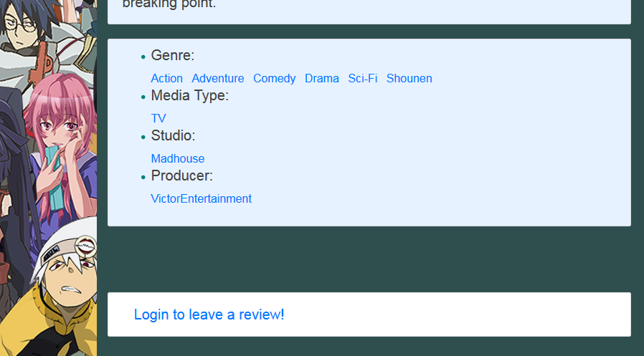
The Review Page
Users cannot leave reviews on anime without logging in.
The login request links to the login page for convenience.

Slide 12
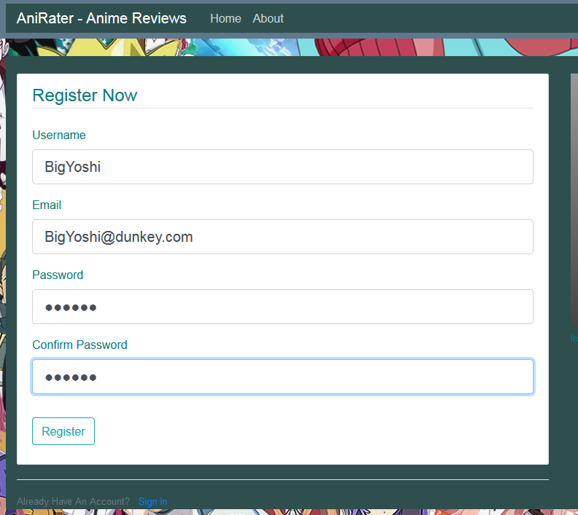
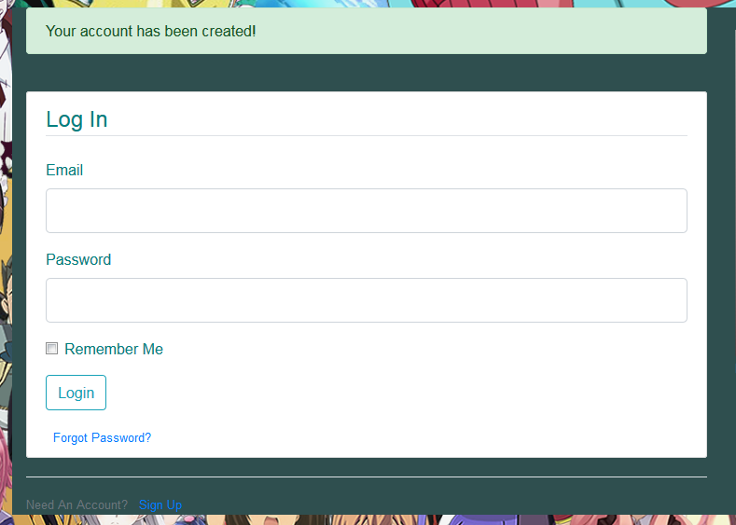
Registering on Anirater
New registers are immediately sent to the login page.

Slide 13
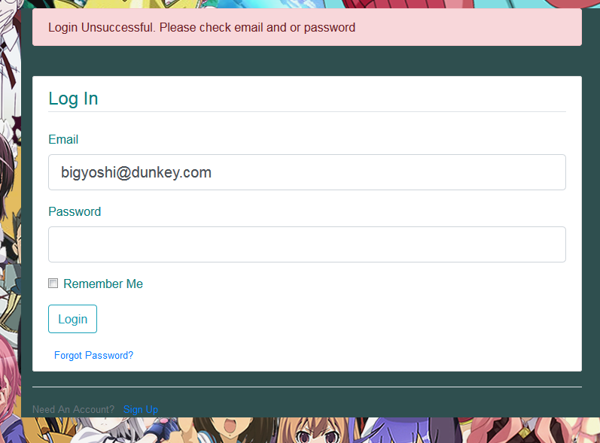
Login!
Remember, capitalization counts! Make the name the way you registered!

Slide 14
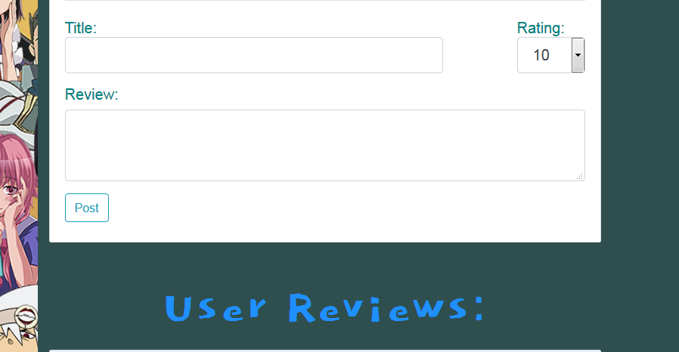
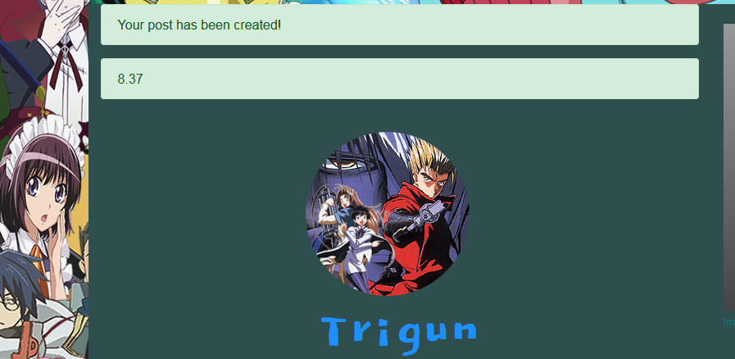
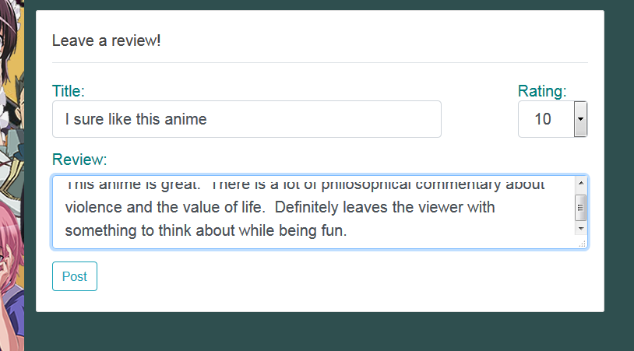
Leaving a Review:
Once logged in, you can leave a review
Success messages appear up top after posting
Write and Rate!

Slide 15
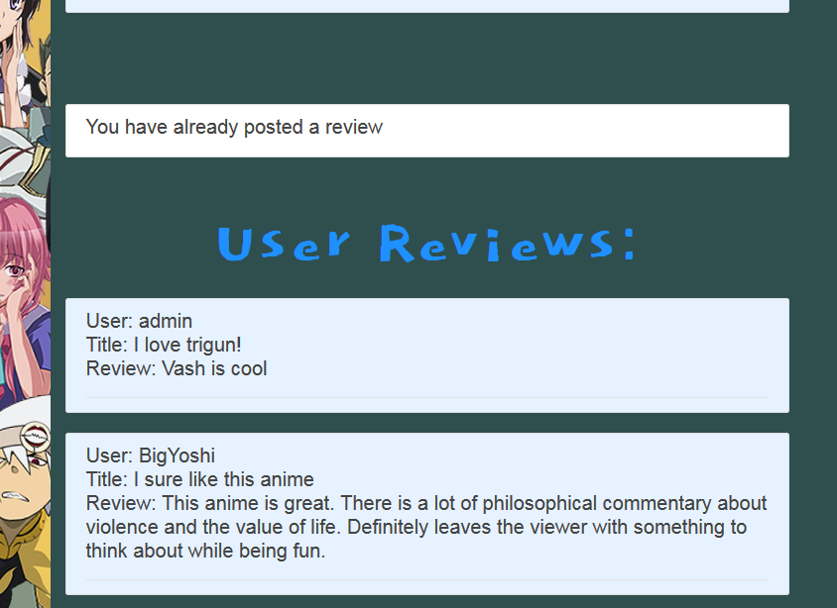
Peruse the reviews, with yours on top!
If your account has already posted a review, it cannot post another.

Slide 16
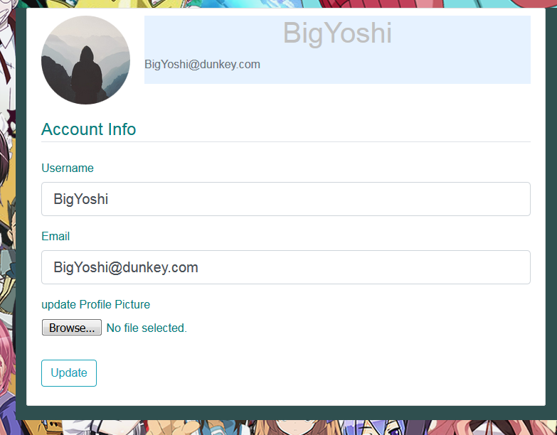
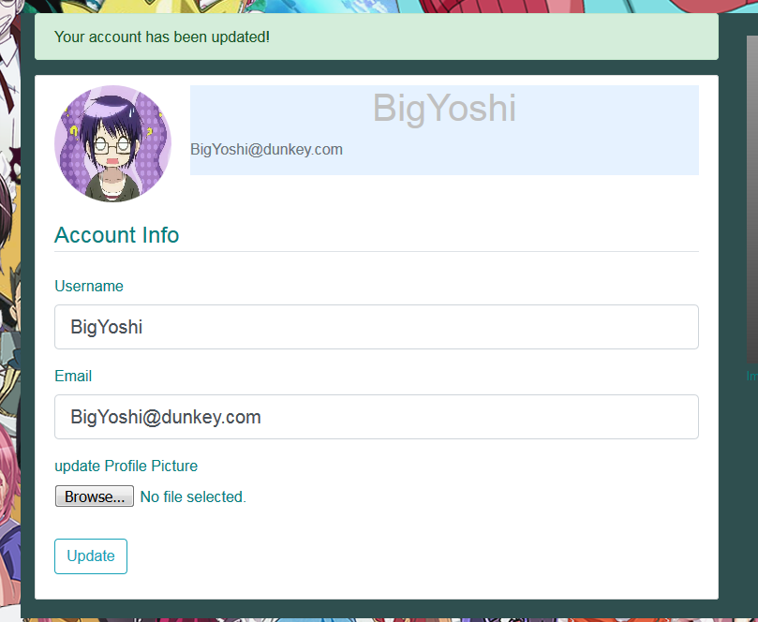
The user has a profile
Changing the default account
picture to a new image…

Slide 17
Part 3: The Code Behind the Concept
All the ticky-typing that goes into making spiffy sites.

Slide 18





What is being used?

Slide 19
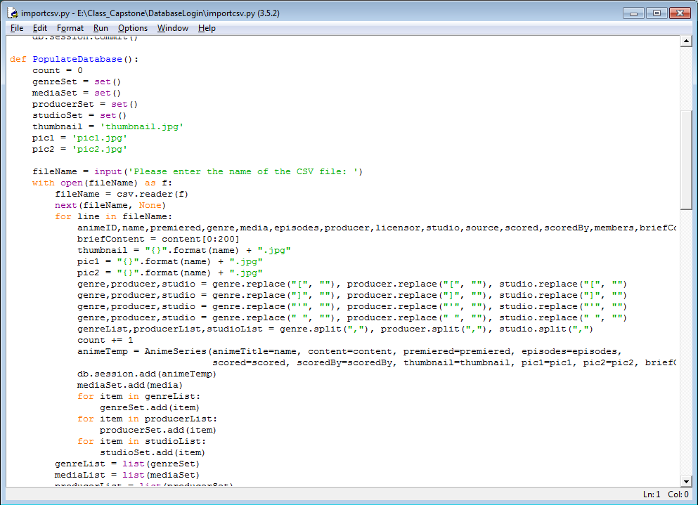
Loading in the Anime
The anime titles and information are all listed in a convenient csv file. This is the python file that loads in the information to be used in the rest of the program.

Slide 20
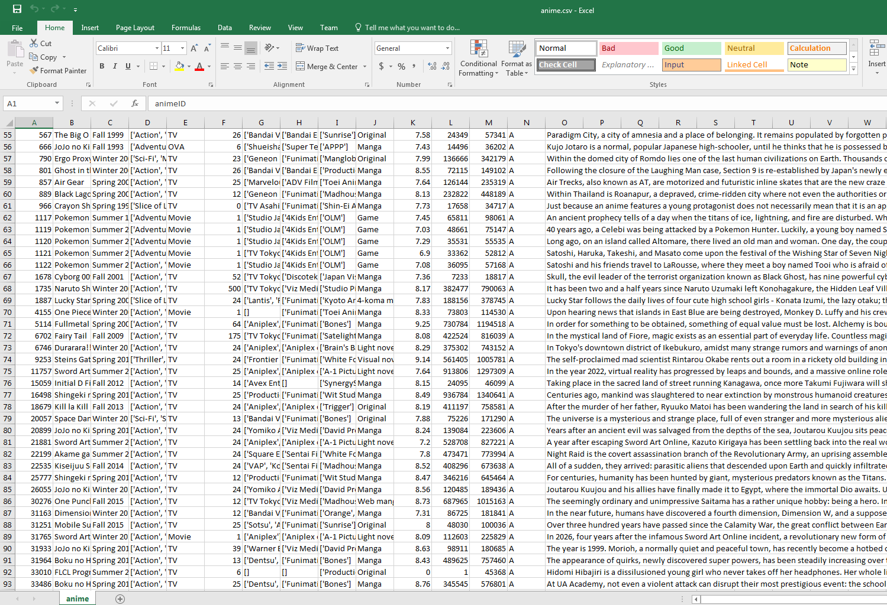
Here is our anime source csv file. It was created by gathering data from the internet, then cropping down to acceptable anime. (i.e. no hentai)

Slide 21
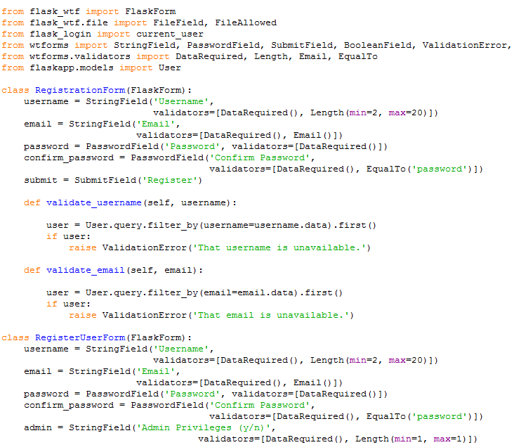
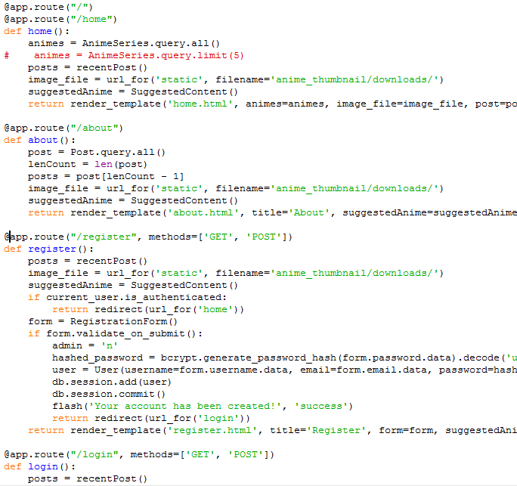
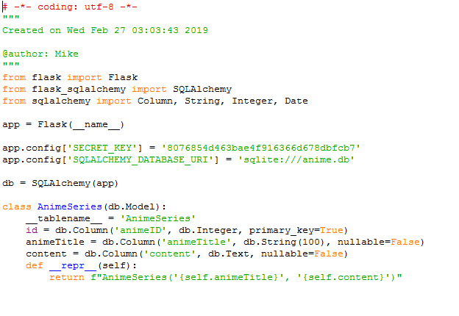
Base Code:
Creating Users
Userforms must be created to insure that each user has a unique username and that there is only one user per email address
Page Links
Importing Anime
Because clicking a flashy thing does nothing if there’s nothing to tell the site where to go
This takes the anime and loads it into the sql database

Slide 22
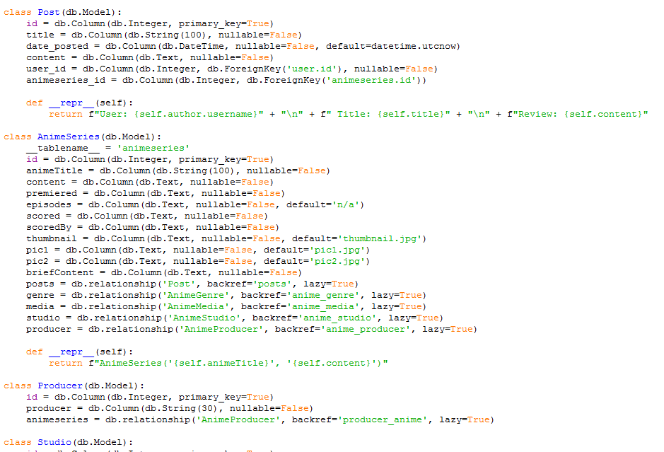
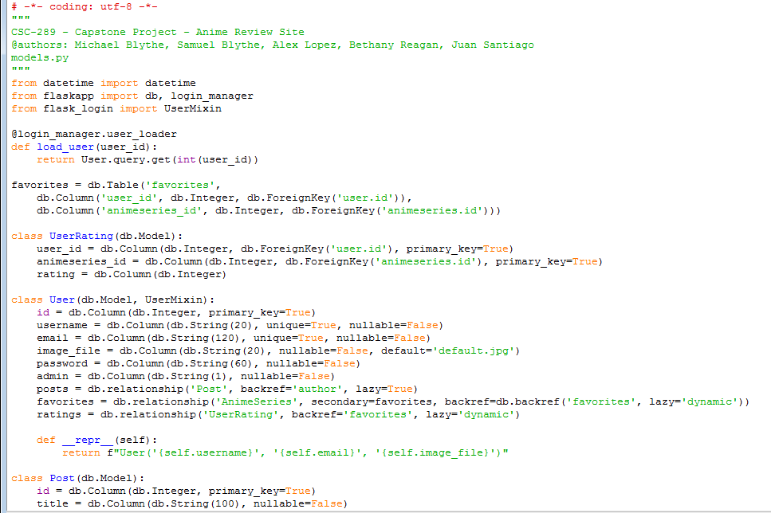
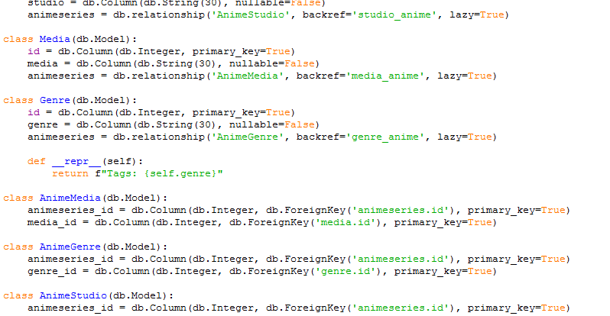
Models.py
Classes are used to keep information separate and easy to load into the pages.

Slide 23
Part 4: Forums
Y’all kids behave now, and no spamming.

Slide 24
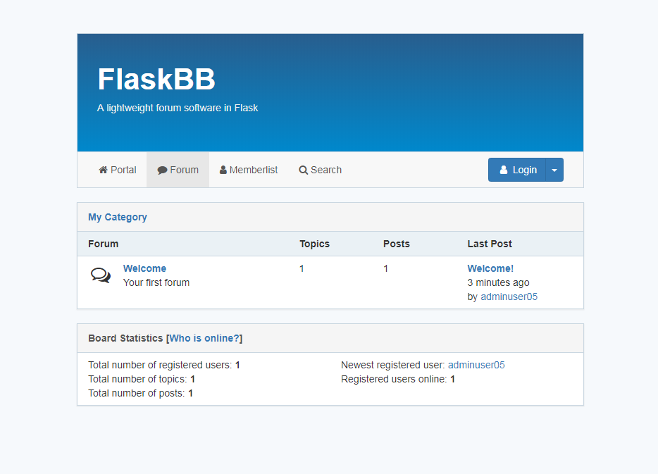
Anime Forums!
Unfortunately, they are at this time a separate login.

Slide 25
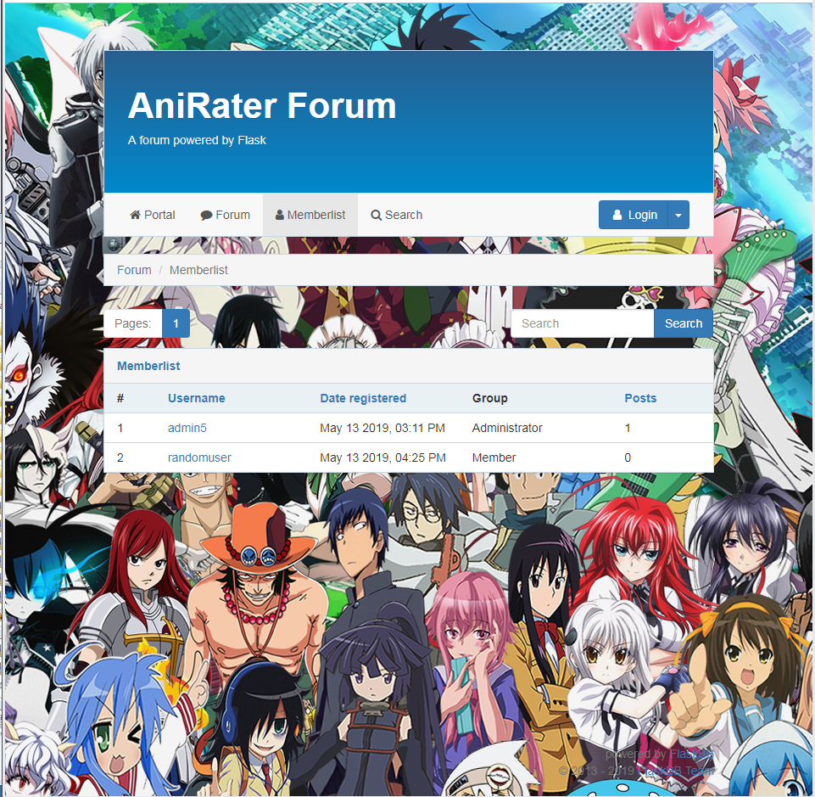
See? Look how lovely it is when you log in. Don’t you want to be a part of this anime community?

Slide 26

Looking forward to a hypothetical future!
Editing posts
Uploading relevant pictures to each anime page
Affiliate links
Private messaging
Single login for site and forums
Search engine optimization
Merging concept layout with the newest program features

